Slide 1
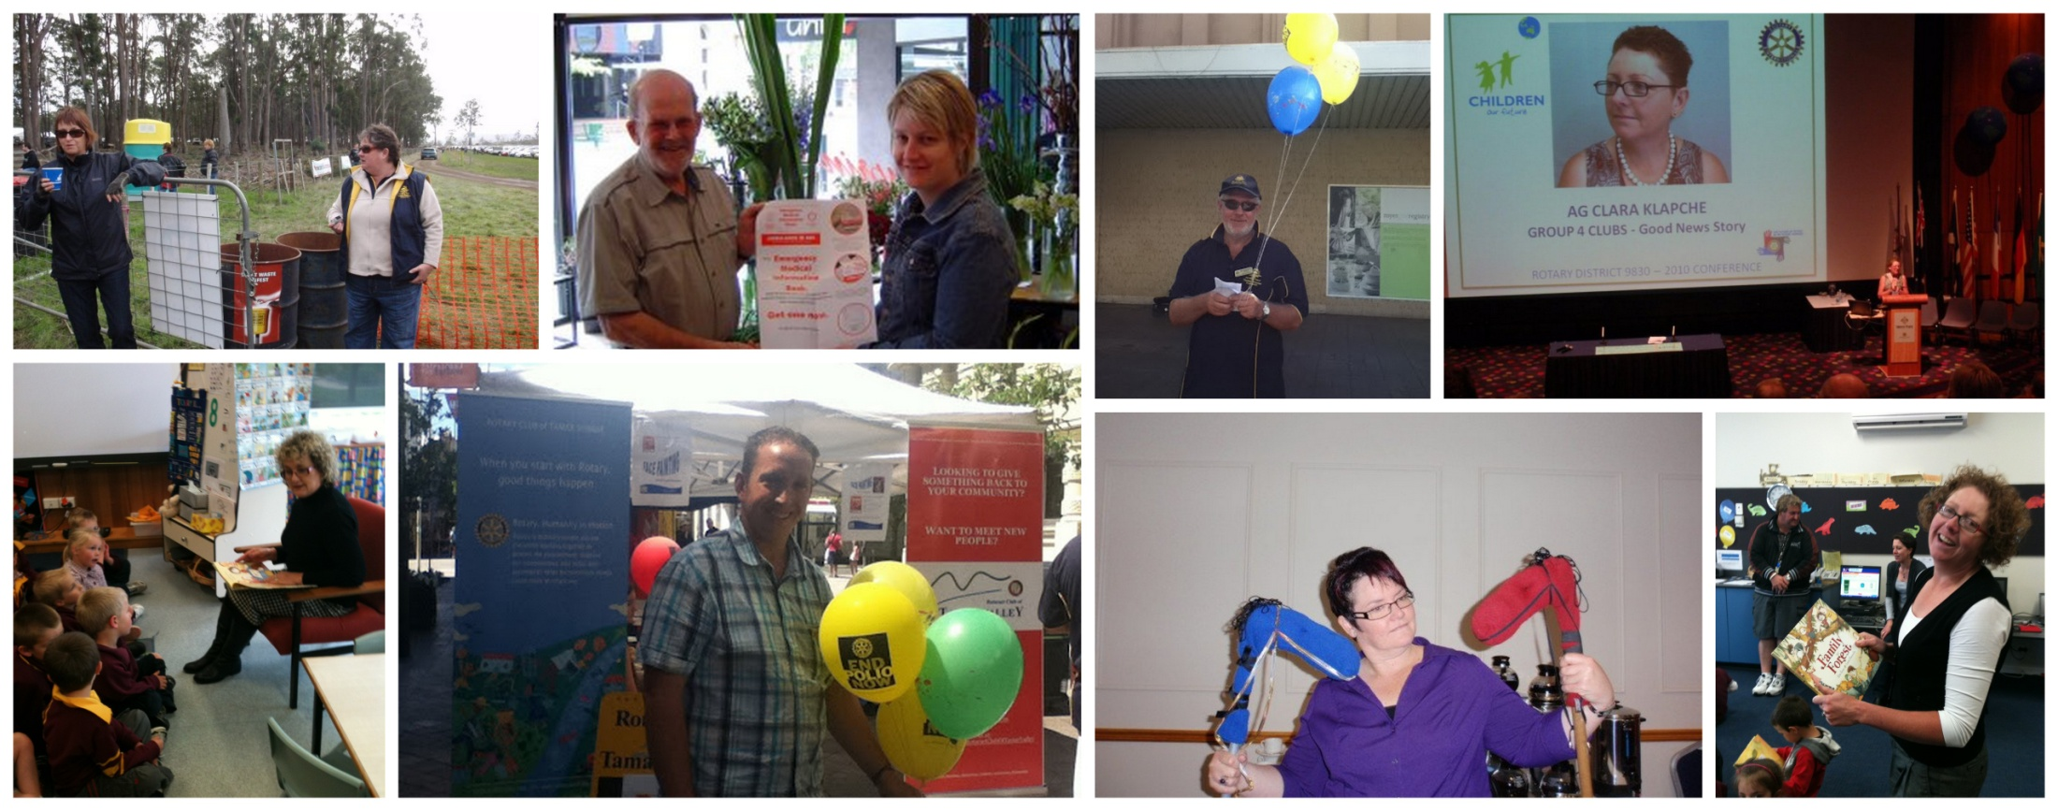
Annual Planning Session 3: 2013 /14

Slide 2
Session Plan
Icebreaker and Welcome
Strategic Planning Recap
Club Business Speed Dating
Process Mapping
Fundraising and Projects for 2013 2014

Slide 3
Icebreaker
Match the Club Member to the information
If you guess correctly – 1 point for you!
If the answer is not correct – the point goes for the correct person

Slide 4
No. | Favourite thing to do on holidays | If you were stranded on an island what 3 things couldn't’ you do without? | 1 thing on your bucket list? | Who?
1 | Laugh, read and try new things | Family, friends and Chanel no 5 | New Years in Times Square
2 | Sightsee | Family, Books, Music | Skydiving
3 | Like to involve water in some way | Reading material (i.e. book, Ipad, kindle) | 3 weeks in Italy
4 | Visit warmer places | Wife, Books, Good wine | Tour around Australia
5 | Relax and Shop | Moisturiser, water, Food (in that order!) | To live overseas (temporarily) and learn a new language
6 | Food, Wine Tours | Iphone, sunglasses, water bottle
7 | Walking around, history | Kindle, Wine, Music | Skydiving
8 | Relax and Explore | Kindle, Beer, Boat | Trail Bike though Laos Jungle
9 | Relax! | Wonderful husband, Husbands skill and humour, my humour | Skyding
10 | Go away with family | Sunglasses, Pillow, Knife | Visit Augusta national
11 | Look at the ocean | Radio National, Comfy bed and good footwear | Live in another country.
12 | Not answer emails | Samboy BBQ Chips, Radio National Breakfast Program, My Fur Kids | Participate in a hunt.
13 | Relax at a swim up bar | Book, Sunglasses, Ipad | Visit rio
Who: | Danny, Lou, Peta, Warwick, Toni, Janice, Jane, Melissa, Clare, Judy, Rod, Leigh, Susan

Slide 5
Strategic Planning Recap
Key Themes Emerging from Discussion on reasons for joining and experience of Rotary
Wanting to have involvement in community and contribute was major influence to join
Opportunity to have a network outside of work
Lack of formality in Tamar Sunrise was appealing after experience of older clubs
Some found club welcoming others found it hard to break into clique when first arrived
Good Guest Speakers have been inspirational and created a dynamic atmosphere they also provide insight into other aspects of community not relevant to day to day life of some members

Slide 6
Strategic Planning Recap
Issues Raised that Require Further Club Input
Club should develop more structure around meetings and planning so that there is better organisation around meetings and activities and it is clear what has been decided. Initial discussion valued lack of formal structure in club which sets it apart from other Rotary clubs. Latter discussion recognised the value in some structure to ensure adequate decision making processes are in place
Club should set aside annual planning session to determine activities for year ahead. Preferable for this to be whole of club activity rather than board
Club should develop brand strategy –
Tamar Sunrise to be primary brand with Rotary sub brand
How do you leverage brand at each event. Eg media exposure in event promo’s, advertising at event (includes branding of members)
Measures of success include awareness within community of club, new members are attracted to join by perception of club

Slide 7
Strategic Planning Recap
Issues Raised that Require Further Club Input
Activities to be supported by the club should be identified first before fund raising action is planned. This allows purpose of fund raising to be included in marketing.
Frequency of meeting. Discussion recognised difficulty for members to attend weekly however less frequent meetings can negatively impact even more on members with other commitments (eg fortnightly meetings could result in members only coming once in a month or less frequently). Attendance recording may need to allow for increased flexibility for attendance
Guest speakers. Discussion acknowledged value of guest speakers and how they can inspire and educate members, it also questioned whether speakers should be required for all meetings. There may be value in setting aside one meeting per month for member business to be dealt with instead of guest speaker

Slide 8
Strategic Planning Recap
Recommendations for Meetings
Meetings need to start on time and members need to be made aware of this
Food orders need to be placed by X time so breakfast can be delivered and eaten in time to fit with meeting
Better structure for guest speaker timing so head table food is not delivered whilst speaking
Proper introductions required for guest speaker. Person doing intro needs to have organised info prior to meeting
Need person to welcome at door members and guests as they arrive
Change name from “grace” to Tamar Sunrise Welcome – important to retain as it reminds members of Rotary purpose but doesn’t need religious overtone

Slide 9
Club Business – Speed Dating
Area | Includes; | Facilitator
Member Services | Member Retention New Members Social activities Rotaract Vocational | Madeline
Publicity, Communication and Promotion | Website Twitter Facebook Logos and branding Club Collateral Electronic Newsletter Media Releases | Peta
Club administration / management | Club Calendar Meeting structure and protocols Club structure Budget and financials Policies and Procedures Club forums Fundraising Risk Management | Toni / Rod
Tell your date:
What is working well
What would you like to see the club focus on in 2013 / 2014
Ideas will be collated by the facilitator

Slide 10
Process Mapping
Blue Sky Process Mapping
What is the club’s process for selecting what we support and are involved in?
What does this look like now?
What do we want this to look like in 2013 / 2014

